Slide 1
Arcade Game Project
Team 2-10 : Jingwen Wu & Haoxuan Sun

Slide 2
Design Goal

Slide 3
Extra Feature
Overview
1. Animation of characters (hero & monsters; do directions)
2. Start page with animation and game instructions
3. End page showing highest score
4. Status bar indicating passed time, hero’s lives and number of collected diamonds .
5. Sound effects and background music
6. Hero can shoot: bullets only hurting enemy

Slide 4









Images & Animation
Hero
Monster
Ice ball
Brick
Fire ball
EXP

Slide 5
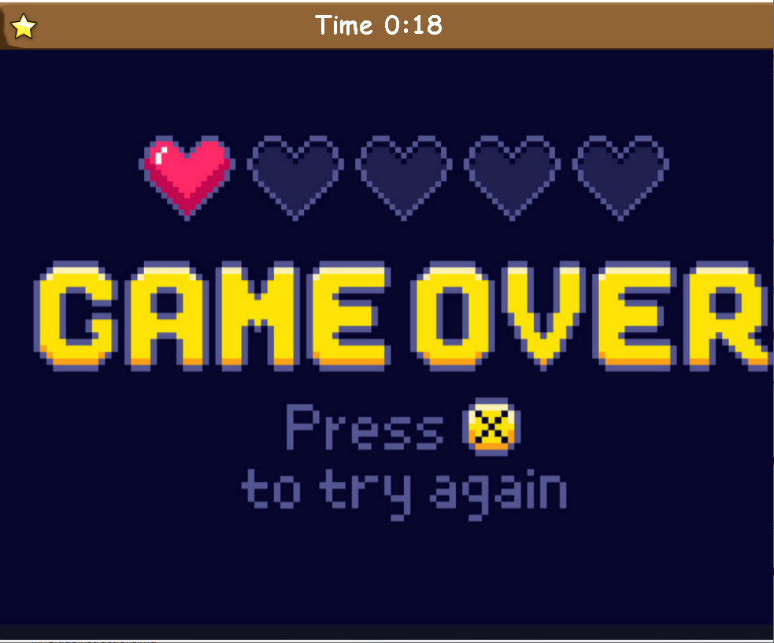
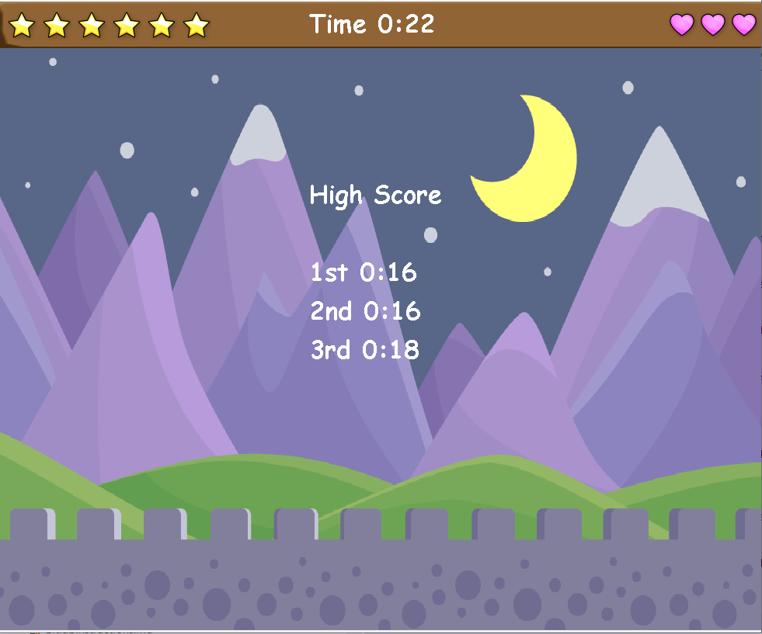
Status Bar & End Page
EXP Level
Passed Time
Life Bar

Slide 6
Start Page

